Slide 1
CANINE INSIGHTS
Presented by: Pradhakshana Duraiswamy
Last Updated on: March 23rd 2024

Slide 2
Table of Contents
Purpose Statement
Story (with Data)
Conclusion

Slide 3
Objective
The goal of this project is to conduct a thorough analysis of dog breeds, focusing on key factors such as size, lifespan, ranking, and score (derived from various breed characteristics). By uncovering insights from this analysis, we aim to provide valuable information that can benefit individuals and organizations within the dog ownership community.

Slide 4
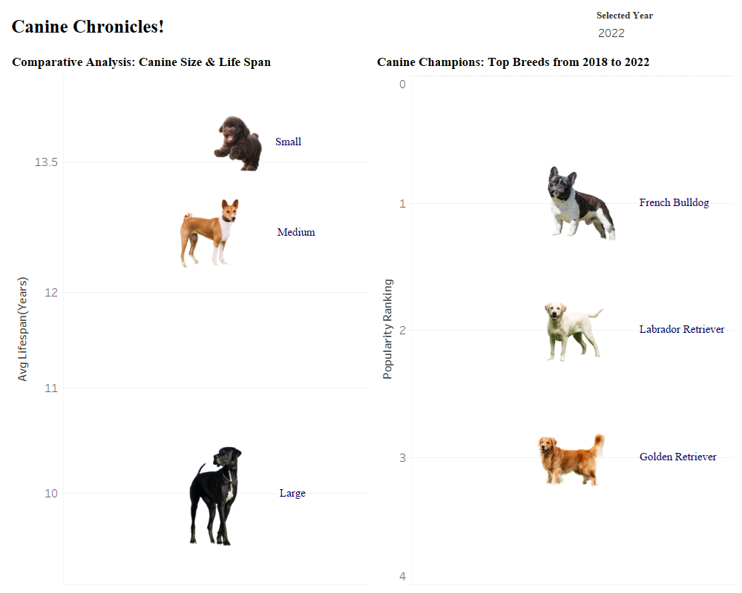
Size, Lifespan and Popularity
There exists a correlation
between the size of a dog breed and its lifespan, indicating that smaller breeds tend to have longer lifespans.
The top three breeds from 2018 to 2022 are medium sized breeds.

Slide 5
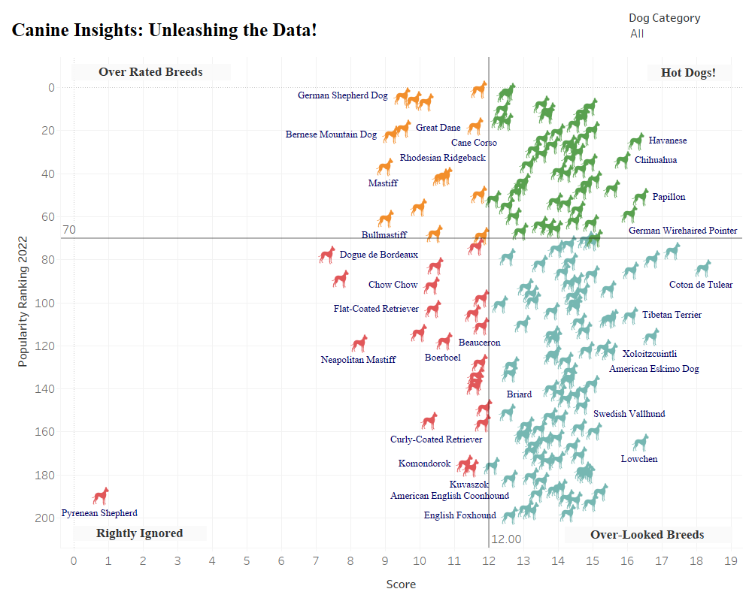
Clustering
The dog breeds are clustered into four categories: "Hotdogs," "Overlooked," "Overrated," and "Rightly Ignored," based on their score and popularity ranking (year 2022).
Score is calculated as follows: (w1*lifespan + w2*demeanor + w3*energy_level – w4*grooming_frequency – w5*shedding_frequency)

Slide 6
Conclusion
1.
2.
3.
Size and Lifespan of dogs are
correlated.
The most popular breeds are
medium sized.
Clustering aids in enhancing
our understanding of different
dog breeds by organizing them
into distinct categories.

